Slide 1

STAT 628
Yelp Reviews Analysis
Yuechuan Chen, Chenhao Fang, Mengqi Li

Slide 2
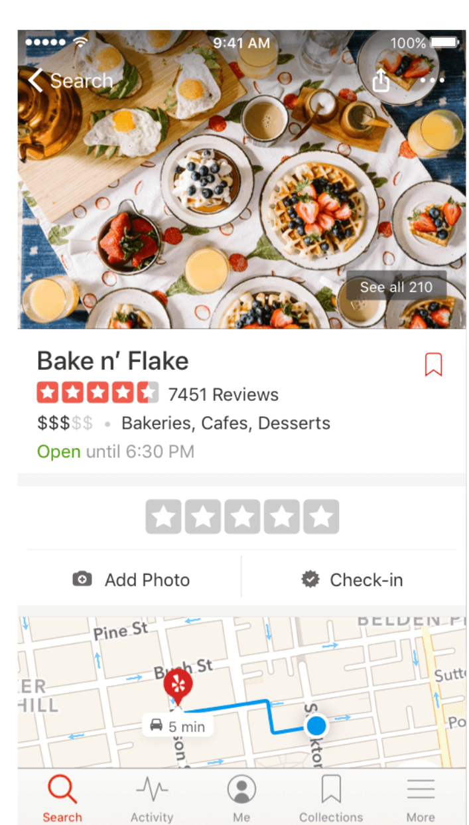
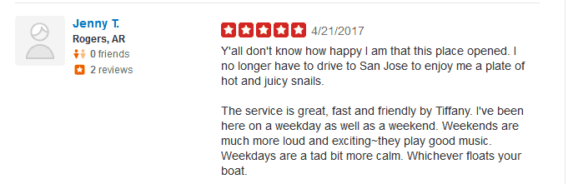
Introduction

Slide 3
Data Cleaning
Raw data:
36,327 businesses and 942,027 reviews
Restaurants which serve desserts:
619 businesses and 36,118 reviews

Slide 4
Data Cleaning: Reviews
Change all the text data to the lower case.
Remove all punctuation characters in the text data.
Tokenize using regular expression.
Stopwords use built-in dictionary in nltk.corpus.stopwords.
Use nltk.stem.wordnet lemmalizer to lemmatize the words.
'Great place for wine and pizza!! They even have a vegan pizza!! It is so hard to find a place with vegan cheese and sausage. Love going there for happy hour. The outside seating is awesome too.'
'great','place','wine','pizza','even','vegan','pizza','hard','find','place','vegan','cheese','sausage','love','going','happy','hour','outside','seating', 'awesome'
After cleaning

Slide 5
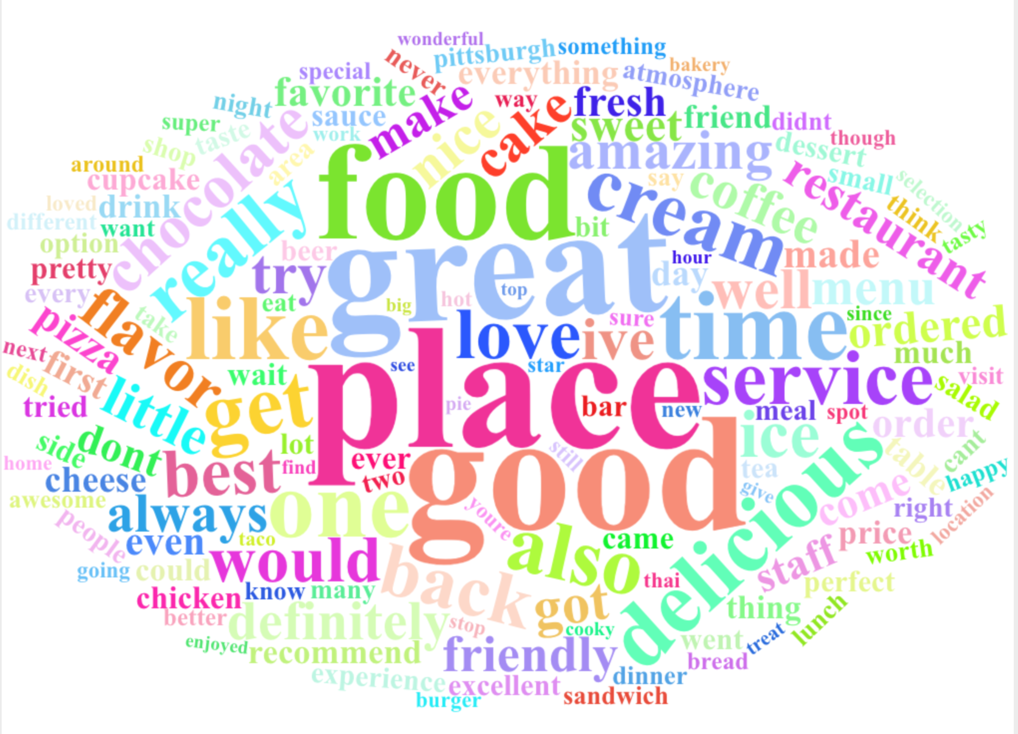
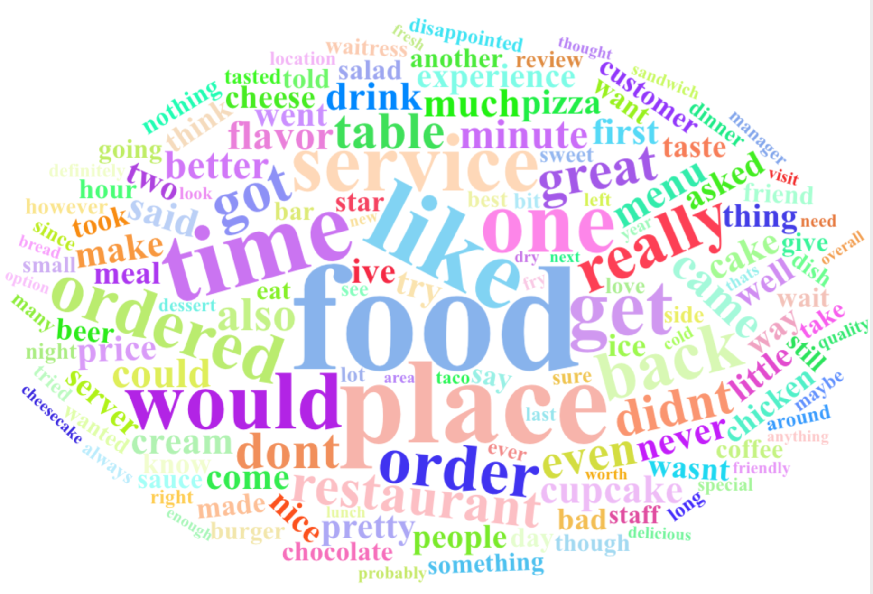
Word Cloud

Slide 7
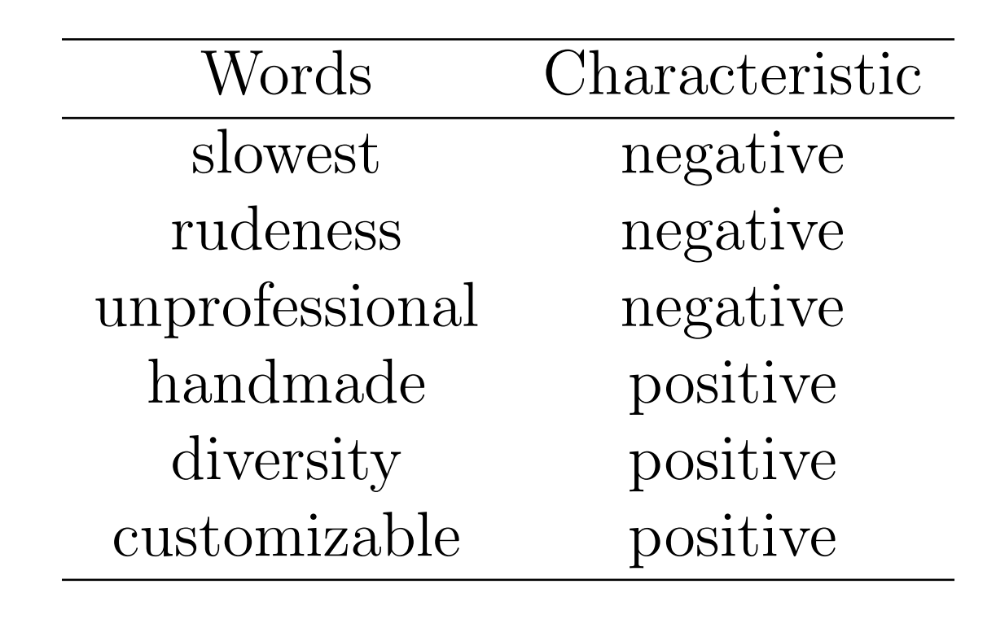
Recommendation: Service

Slide 8
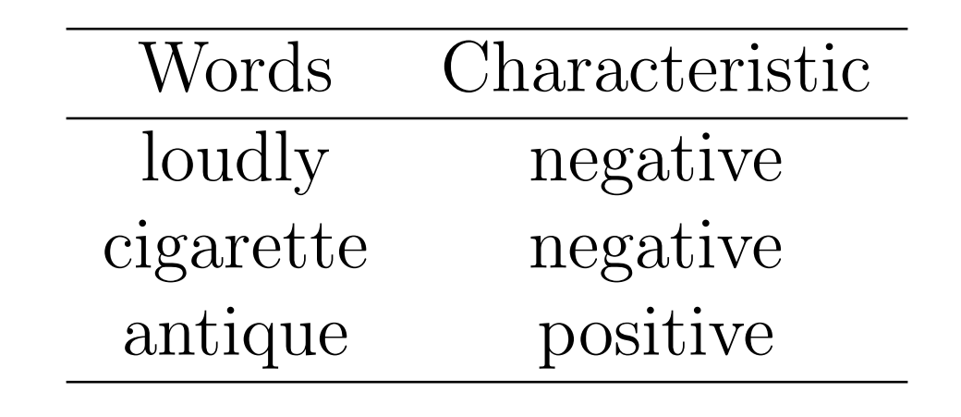
Recommendation: Environment

Slide 9
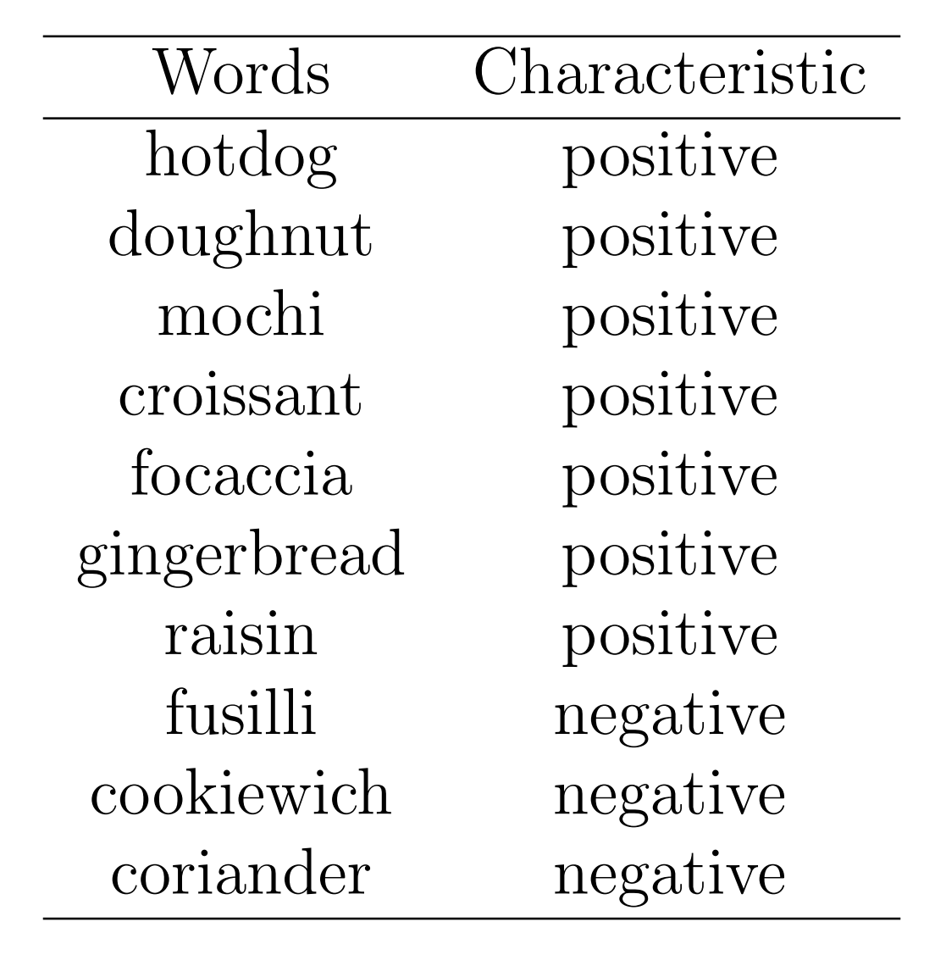
Recommendation: Food

Slide 10
Thank you for listening!
Try at: https://ustclink.shinyapps.io/yelp-comment/

